Slide 1
Replication of
“Graph Convolutional (GCN)
Label Noise Cleaner (LNC):
Train a Plug-and-play Action
Classifier for Anomaly Detection”
– By Kapil Wanaskar

Slide 2
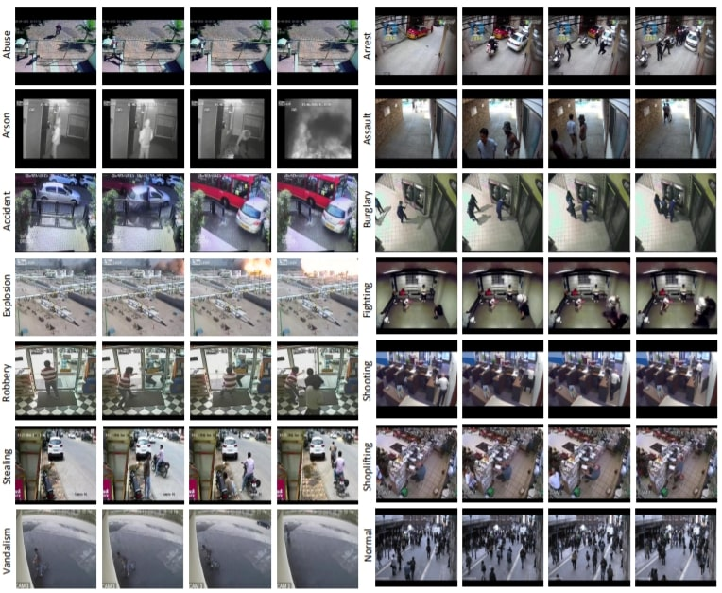
Why is it Important?
What is the Problem Statement?
Notes:
Why is it Important?
Anomaly detection is vital for public safety and surveillance applications.
Enhancing accuracy under weak labels has significant real-world implications.
Validating existing research benefits the scientific community and practical applications.
What is the Problem Statement?
Replicating "Graph Convolutional Label Noise Cleaner" for anomaly detection.
Focus on testing and validating the model on the UCF-Crime dataset.
Demonstrating the model's efficacy in cleaning noisy labels to improve anomaly detection.

Slide 3
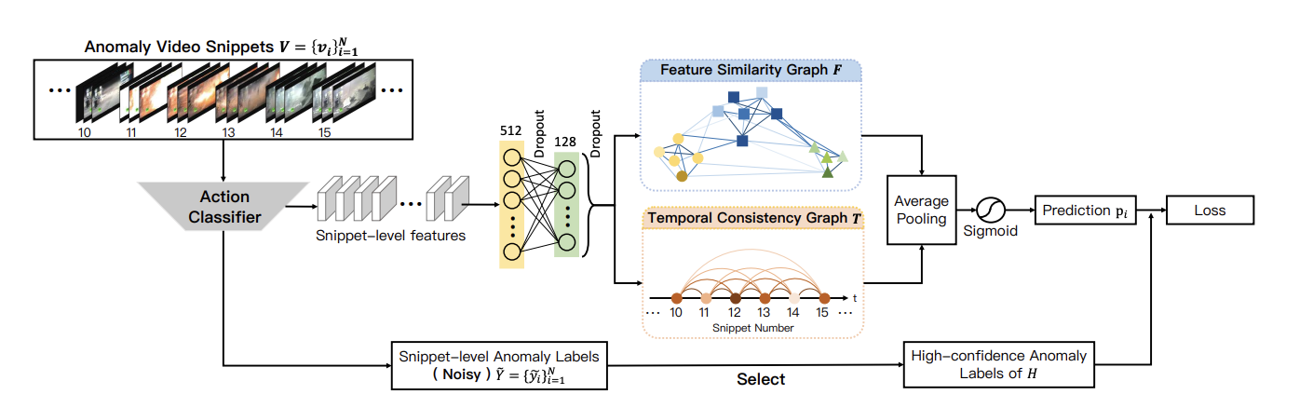
Execution Plan:
Figure 2: Overview of the training process of label noise cleaner.
Notes:
The action classifier
extracts spatio-temporal features from anomalous video snippets and
outputs noisy snippet-level labels.
Snippet-level features from the classifier are compressed and fed into two graph modules
to model the feature similarity and temporal consistency of snippets.
In the two graph based modules, A darker node represents higher anomaly confidence of the snippet.
The output of these two models are fused and utilized to predict the snippet-level labels with less noise.
The loss is updated to correct the predictive noise via high-confidence snippets.

Slide 4
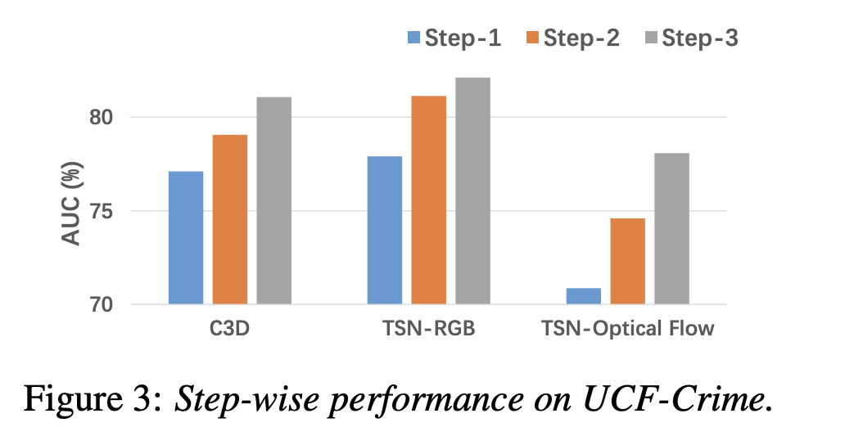
Challenge:
Notes:
C3D (3D Convolutional Networks):
The network takes into account not only the spatial dimensions of the input video frames but also the temporal dimension,
essentially treating time as a third dimension.
This is particularly useful for understanding and capturing motion information in video sequences.
TSN (Temporal Segment Networks):
A method for action recognition in videos that incorporates a two-stream architecture:
TSN-RGB: the TSN that processes the RGB frames of a video (the spatial stream). This stream focuses on capturing the appearance information from the static frames.
TSN-Optical Flow: The part of the TSN that processes the optical flow between video frames (the temporal stream).
Optical flow is a representation of motion between two frames and is used by the network to understand how objects in the scene move over time.
Step 1: Initial feature extraction or baseline training without any additional techniques or layers.
Step 2: Incorporation of label noise cleaner
Step 3: reflects that excessive iterations may deteriorates on the detection performance

Slide 5
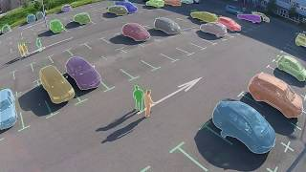
Planned Extension Part
Notes:
Extend the GCN-LNC model to the Mini-drone video dataset for future research.
Adapt the feature extraction and training process for drone footage characteristics.

